Slide 1
The Advice Quality Standard
http://www.advicequalitystandard.org.uk/
http://www.recognisingexcellence.co.uk/Advice_Quality_Standard_

Slide 2
What is the Advice Quality Standard?
An organisational quality assurance audit
Gifted to the Advice Services Alliance by the former Legal Services Commission in 2012
Owned and managed by the Advice Services Alliance through an independent Project Management Committee, chaired by Professor Avrom Sherr
Held by over 650 separate social welfare legal advice services across England and Wales

Slide 3
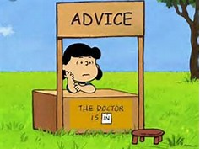
‘Social Welfare Legal Advice Services’
Who can apply for the AQS?

Slide 4
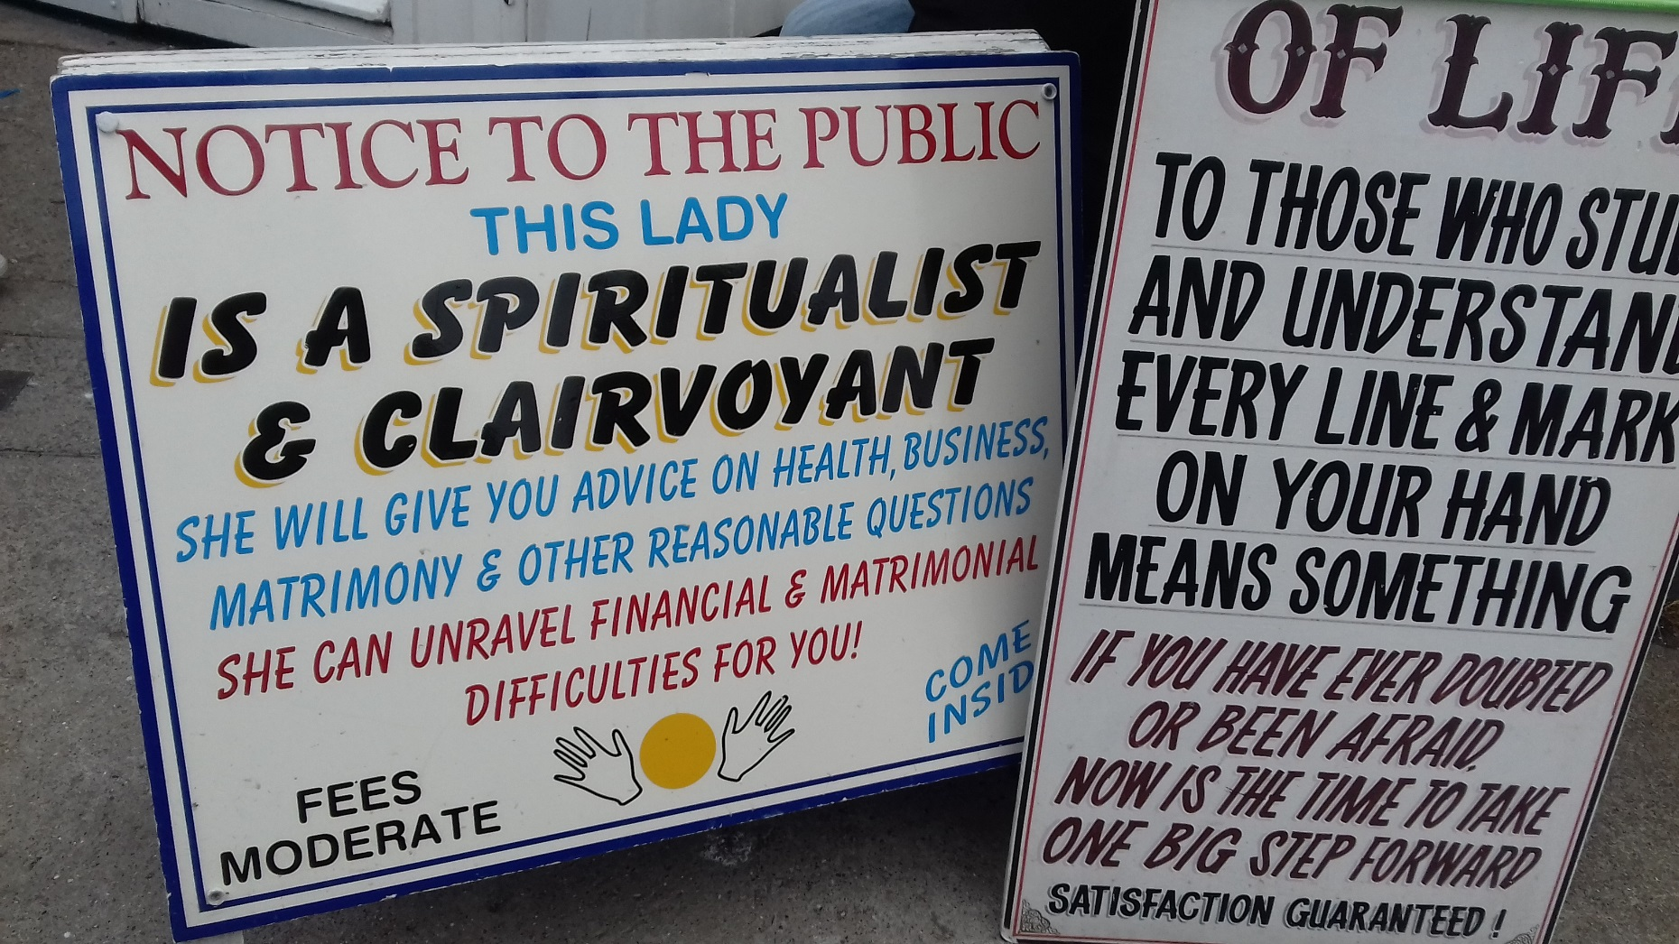
Who is not suitable for the AQS?
Notes:
AQS is a floor standard, not a ceiling
AQS is an MOT style standard, beware bad drivers
Does not cover key areas of quality i.e peer review
Beware of the smell of new paint
Must not overload, but must be robust
Must be flexible, valid and applicable to varied services
Not regulatory, nor compulsory, ‘no teeth’?
Compassion and commitment to social justice

Slide 5
Core Elements of the AQS
Specification of Quality Assurance Standards
Independent Audit to ensure standards are met and maintained
Continuous improvement in the service offered

Slide 6
Structure of the AQS Assessment
A. Access to Service Ensuring access to service
B. Seamless Service Referrals and case handling
C. Running the organisation Organisation well managed
D. People Management People are well managed
E. Running the Service Advice properly managed
F. Meeting client’s needs Clients receive good service
G. Commitment to Quality Maintain quality throughout

Slide 7
Tailored to different types of services
Levels of advice offered
Advice level
Advice with casework level
Telephone requirements
Delivery methods
Face to face or telephone
Client Groups
Specialist Area of Law
There is no such thing as an average advice service!

Slide 8
What are quality standards about?

Slide 9
Why ‘Quality’?
Quality services are simply better
Assurance to the public and your clients
Statement of values to funders
Common language between organisations
Helps trustees govern more effectively
Focuses attention on issues that matter
Part of a community of over 650 AQS holders
(But it is tough, time consuming and can spotlight issues)

Slide 10
What does this mean in practice?
First time AQS applicants: desk top audit plus on site assessment
Award lasts for 2 years
Expectation that continue to meet the standard and to develop
Assessment visit prior to expiry date for continuous award
AQS is recognised by the Money Advice Service
AQS is in the process of assessment against the Welsh Framework
AQS is recognised by some funders and a requirement of others

Slide 11
The Advice Quality Standard
http://www.advicequalitystandard.org.uk/
http://www.recognisingexcellence.co.uk/Advice_Quality_Standard_

